Slide 1
Finite-State Machines
CS 236
Fall 2023

Slide 2
Overview and Due
State machines
Elements of state machine definition
Lexing
Due
HW 2 due today
HW 3 due Monday
HW 4 due Wednesday
Project 1 due Tuesday, Sept 28
You can start project 1 today, but we’ll finish the lecture on Monday

Slide 3
New rooms beginning on Monday
11am section. C S 236-003 MWF 11:00-11:50 in JFSB B037
1pm section. C S 236-001 MWF 1:00-1:50 in MCKB 115

Slide 4
New testing procedures coming next week
We've run into some resource limits from github and are working through them. In the next few days, we'll make a change to the testing so that tests will only be run when you submit a pull request (in contrast to automatically running tests every time you submit your code to github). This means that you will need to use the pytest command line method to check whether your code works rather than getting feedback from github. The TAs are preparing a document with a step-by-step guide for what you'll need to do to get your code graded after you know that your code passes all tests.

Slide 5
Big Picture
Applying Regular Expressions to Lexing … kinda

Slide 6
What is Lexing?
Datalog program
Lexer
tokens

Slide 7
What is Lexing?
Schemes:
f(A,B)
g(C,D)
Facts:
f('1','2').
f('4','3').
g('3','2').
Rules:
Queries:
f('3',Z)?
g(‘3’,Z)?
Lexer
tokens
Datalog is a database programming language

Slide 8
What is Lexing?
Schemes:
f(A,B)
g(C,D)
Facts:
f('1','2').
f('4','3').
g('3','2').
Rules:
Queries:
f('3',Z)?
g(‘3’,Z)?
Lexer
tokens
Datalog is a database programming language
It has four keywords: Schemes, Facts, Rules, Queries

Slide 9
What is Lexing?
Schemes:
f(A,B)
g(C,D)
Facts:
f('1','2').
f('4','3').
g('3','2').
Rules:
Queries:
f('3',Z)?
g(‘3’,Z)?
Lexer
tokens
Datalog is a database programming language
It has many special symbols: comma, period, parentheses, colon, …

Slide 10
What is Lexing?
Schemes:
f(A,B)
g(C,D)
Facts:
f('1','2').
f('4','3').
g('3','2').
Rules:
Queries:
f('3',Z)?
g(‘3’,Z)?
Lexer
tokens
Datalog is a database programming language
It has user-defined identifiers, strings, and comments

Slide 11
What is Lexing?
Schemes:
f(A,B)
g(C,D)
Facts:
f('1','2').
f('4','3').
g('3','2').
Rules:
Queries:
f('3',Z)?
g(‘3’,Z)?
Lexer
tokens
Datalog is a database programming language
Lexing finds the keywords, symbols, and user-defined things

Slide 12
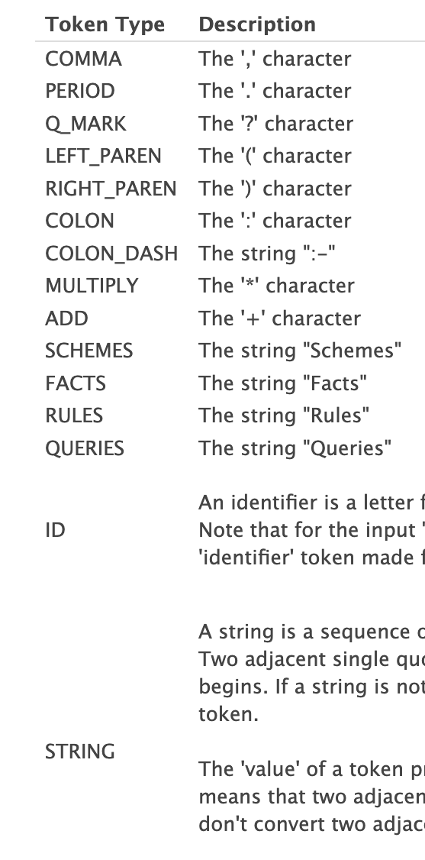
What is Lexing?
This table from Project 1 shows all regular patterns in Datalog
Schemes:
f(A,B)
g(C,D)
Facts:
f('1','2').
f('4','3').
g('3','2').
Rules:
Queries:
f('3',Z)?
g(‘3’,Z)?
Lexer

Slide 13
What is Lexing?
This table from Project 1 shows all regular patterns in Datalog
Lexing “pulls out” these patterns
Schemes:
f(A,B)
g(C,D)
Facts:
f('1','2').
f('4','3').
g('3','2').
Rules:
Queries:
f('3',Z)?
g(‘3’,Z)?
Lexer

Slide 14
What is Lexing?
(SCHEMES,"Schemes",1)
(COLON,":",1)
(ID,"f",2)
(LEFT_PAREN,"(",2)
(ID,"A",2)
(COMMA,",",2)
(ID,"B",2)
(RIGHT_PAREN,")",2)
(ID,"g",3)
(LEFT_PAREN,"(",3)
(ID,"C",3)
(COMMA,",",3)
(ID,"D",3)
(RIGHT_PAREN,")",3)
(FACTS,"Facts",5)
(COLON,":",5)
(ID,"f",6)
(LEFT_PAREN,"(",6)
(STRING,"'1’”,6)
(COMMA,",",6)
(STRING,"'2’”,6)
(RIGHT_PAREN,")",6)
(PERIOD,".",6)
(ID,"f",7)
(LEFT_PAREN,"(",7)
(STRING,"'4’”,7)
(COMMA,",",7)
(STRING,"'3’”,7)
(RIGHT_PAREN,")",7)
(PERIOD,".",7)
(ID,"g",8)
(LEFT_PAREN,"(",8)
(STRING,"'3’”,8)
This is the list of patterns found in the Datalog program
Schemes:
f(A,B)
g(C,D)
Facts:
f('1','2').
f('4','3').
g('3','2').
Rules:
Queries:
f('3',Z)?
g(‘3’,Z)?
Lexer

Slide 15
What is Lexing?
(SCHEMES,"Schemes",1)
(COLON,":",1)
(ID,"f",2)
(LEFT_PAREN,"(",2)
(ID,"A",2)
(COMMA,",",2)
(ID,"B",2)
(RIGHT_PAREN,")",2)
(ID,"g",3)
(LEFT_PAREN,"(",3)
(ID,"C",3)
(COMMA,",",3)
(ID,"D",3)
(RIGHT_PAREN,")",3)
(FACTS,"Facts",5)
(COLON,":",5)
(ID,"f",6)
(LEFT_PAREN,"(",6)
(STRING,"'1’”,6)
(COMMA,",",6)
(STRING,"'2’”,6)
(RIGHT_PAREN,")",6)
(PERIOD,".",6)
(ID,"f",7)
(LEFT_PAREN,"(",7)
(STRING,"'4’”,7)
(COMMA,",",7)
(STRING,"'3’”,7)
(RIGHT_PAREN,")",7)
(PERIOD,".",7)
(ID,"g",8)
(LEFT_PAREN,"(",8)
(STRING,"'3’”,8)
Every valid Datalog program follows regular patterns:
Lexing “pulls out” these patterns
Schemes:
f(A,B)
g(C,D)
Facts:
f('1','2').
f('4','3').
g('3','2').
Rules:
Queries:
f('3',Z)?
g(‘3’,Z)?
Lexer

Slide 16
What is Lexing?
(SCHEMES,"Schemes",1)
(COLON,":",1)
(ID,"f",2)
(LEFT_PAREN,"(",2)
(ID,"A",2)
(COMMA,",",2)
(ID,"B",2)
(RIGHT_PAREN,")",2)
(ID,"g",3)
(LEFT_PAREN,"(",3)
(ID,"C",3)
(COMMA,",",3)
(ID,"D",3)
(RIGHT_PAREN,")",3)
(FACTS,"Facts",5)
(COLON,":",5)
(ID,"f",6)
(LEFT_PAREN,"(",6)
(STRING,"'1’”,6)
(COMMA,",",6)
(STRING,"'2’”,6)
(RIGHT_PAREN,")",6)
(PERIOD,".",6)
(ID,"f",7)
(LEFT_PAREN,"(",7)
(STRING,"'4’”,7)
(COMMA,",",7)
(STRING,"'3’”,7)
(RIGHT_PAREN,")",7)
(PERIOD,".",7)
(ID,"g",8)
(LEFT_PAREN,"(",8)
(STRING,"'3’”,8)
Every valid Datalog program follows regular patterns:
Lexing “pulls out” these patterns
Schemes:
f(A,B)
g(C,D)
Facts:
f('1','2').
f('4','3').
g('3','2').
Rules:
Queries:
f('3',Z)?
g(‘3’,Z)?
Lexer

Slide 17
What is Lexing?
(SCHEMES,"Schemes",1)
(COLON,":",1)
(ID,"f",2)
(LEFT_PAREN,"(",2)
(ID,"A",2)
(COMMA,",",2)
(ID,"B",2)
(RIGHT_PAREN,")",2)
(ID,"g",3)
(LEFT_PAREN,"(",3)
(ID,"C",3)
(COMMA,",",3)
(ID,"D",3)
(RIGHT_PAREN,")",3)
(FACTS,"Facts",5)
(COLON,":",5)
(ID,"f",6)
(LEFT_PAREN,"(",6)
(STRING,"'1’”,6)
(COMMA,",",6)
(STRING,"'2’”,6)
(RIGHT_PAREN,")",6)
(PERIOD,".",6)
(ID,"f",7)
(LEFT_PAREN,"(",7)
(STRING,"'4’”,7)
(COMMA,",",7)
(STRING,"'3’”,7)
(RIGHT_PAREN,")",7)
(PERIOD,".",7)
(ID,"g",8)
(LEFT_PAREN,"(",8)
(STRING,"'3’”,8)
Every valid Datalog program follows regular patterns:
Lexing “pulls out” these patterns
Schemes:
f(A,B)
g(C,D)
Facts:
f('1','2').
f('4','3').
g('3','2').
Rules:
Queries:
f('3',Z)?
g(‘3’,Z)?
Lexer

Slide 18
What is Lexing?
(SCHEMES,"Schemes",1)
(COLON,":",1)
(ID,"f",2)
(LEFT_PAREN,"(",2)
(ID,"A",2)
(COMMA,",",2)
(ID,"B",2)
(RIGHT_PAREN,")",2)
(ID,"g",3)
(LEFT_PAREN,"(",3)
(ID,"C",3)
(COMMA,",",3)
(ID,"D",3)
(RIGHT_PAREN,")",3)
(FACTS,"Facts",5)
(COLON,":",5)
(ID,"f",6)
(LEFT_PAREN,"(",6)
(STRING,"'1’”,6)
(COMMA,",",6)
(STRING,"'2’”,6)
(RIGHT_PAREN,")",6)
(PERIOD,".",6)
(ID,"f",7)
(LEFT_PAREN,"(",7)
(STRING,"'4’”,7)
(COMMA,",",7)
(STRING,"'3’”,7)
(RIGHT_PAREN,")",7)
(PERIOD,".",7)
(ID,"g",8)
(LEFT_PAREN,"(",8)
(STRING,"'3’”,8)
Every valid Datalog program follows regular patterns:
Lexing “pulls out” these patterns
Schemes:
f(A,B)
g(C,D)
Facts:
f('1','2').
f('4','3').
g('3','2').
Rules:
Queries:
f('3',Z)?
g(‘3’,Z)?
Lexer
User-defined identifiers have regular patterns.
Look for these regular patterns

Slide 19
What is Lexing?
(SCHEMES,"Schemes",1)
(COLON,":",1)
(ID,”mike0",2)
(LEFT_PAREN,"(",2)
(ID,"A",2)
(COMMA,",",2)
(ID,"B",2)
(RIGHT_PAREN,")",2)
(ID,"g",3)
(LEFT_PAREN,"(",3)
(ID,"C",3)
(COMMA,",",3)
(ID,"D",3)
(RIGHT_PAREN,")",3)
(FACTS,"Facts",5)
(COLON,":",5)
(ID,”mike0",6)
(LEFT_PAREN,"(",6)
(STRING,"'1’”,6)
(COMMA,",",6)
(STRING,"'2’”,6)
(RIGHT_PAREN,")",6)
(PERIOD,".",6)
(ID,”mike0",7)
(LEFT_PAREN,"(",7)
(STRING,"'4’”,7)
(COMMA,",",7)
(STRING,"'3’”,7)
(RIGHT_PAREN,")",7)
(PERIOD,".",7)
(ID,"g",8)
(LEFT_PAREN,"(",8)
(STRING,"'3’”,8)
Every valid Datalog program follows regular patterns:
Lexing “pulls out” these patterns
Schemes:
mike0(A,B)
g(C,D)
Facts:
mike0('1','2').
mike0('4','3').
g('3','2').
Rules:
Queries:
mike0('3',Z)?
g(‘3’,Z)?
Lexer
User-defined identifiers have regular patterns.
Look for these regular patterns

Slide 20
(SCHEMES,"Schemes",1)
(COLON,":",1)
(ID,"f",2)
(LEFT_PAREN,"(",2)
(ID,"A",2)
(COMMA,",",2)
(ID,"B",2)
(RIGHT_PAREN,")",2)
(ID,"g",3)
(LEFT_PAREN,"(",3)
(ID,"C",3)
(COMMA,",",3)
(ID,"D",3)
(RIGHT_PAREN,")",3)
(FACTS,"Facts",5)
(COLON,":",5)
(ID,"f",6)
(LEFT_PAREN,"(",6)
(STRING,"'1’”,6)
(COMMA,",",6)
(STRING,"'2’”,6)
(RIGHT_PAREN,")",6)
(PERIOD,".",6)
(ID,"f",7)
(LEFT_PAREN,"(",7)
(STRING,"'4’”,7)
(COMMA,",",7)
(STRING,"'3’”,7)
(RIGHT_PAREN,")",7)
(PERIOD,".",7)
(ID,"g",8)
(LEFT_PAREN,"(",8)
(STRING,"'3’”,8)
(SCHEMES,"Schemes",1)
(COLON,":",1)
(ID,”mike0",2)
(LEFT_PAREN,"(",2)
(ID,"A",2)
(COMMA,",",2)
(ID,"B",2)
(RIGHT_PAREN,")",2)
(ID,"g",3)
(LEFT_PAREN,"(",3)
(ID,"C",3)
(COMMA,",",3)
(ID,"D",3)
(RIGHT_PAREN,")",3)
(FACTS,"Facts",5)
(COLON,":",5)
(ID,”mike0",6)
(LEFT_PAREN,"(",6)
(STRING,"'1’”,6)
(COMMA,",",6)
(STRING,"'2’”,6)
(RIGHT_PAREN,")",6)
(PERIOD,".",6)
(ID,”mike0",7)
(LEFT_PAREN,"(",7)
(STRING,"'4’”,7)
(COMMA,",",7)
(STRING,"'3’”,7)
(RIGHT_PAREN,")",7)
(PERIOD,".",7)
(ID,"g",8)
(LEFT_PAREN,"(",8)
(STRING,"'3’”,8)
After lexing, two programs that are identical
except for comments, identifier names, and
what’s in strings show identical patterns.

Slide 21
(SCHEMES,"Schemes",1)
(COLON,":",1)
(ID,"f",2)
(LEFT_PAREN,"(",2)
(ID,"A",2)
(COMMA,",",2)
(ID,"B",2)
(RIGHT_PAREN,")",2)
(ID,"g",3)
(LEFT_PAREN,"(",3)
(ID,"C",3)
(COMMA,",",3)
(ID,"D",3)
(RIGHT_PAREN,")",3)
(FACTS,"Facts",5)
(COLON,":",5)
(ID,"f",6)
(LEFT_PAREN,"(",6)
(STRING,"'1’”,6)
(COMMA,",",6)
(STRING,"'2’”,6)
(RIGHT_PAREN,")",6)
(PERIOD,".",6)
(ID,"f",7)
(LEFT_PAREN,"(",7)
(STRING,"'4’”,7)
(COMMA,",",7)
(STRING,"'3’”,7)
(RIGHT_PAREN,")",7)
(PERIOD,".",7)
(ID,"g",8)
(LEFT_PAREN,"(",8)
(STRING,"'3’”,8)
(SCHEMES,"Schemes",1)
(COLON,":",1)
(ID,”mike0",2)
(LEFT_PAREN,"(",2)
(ID,"A",2)
(COMMA,",",2)
(ID,"B",2)
(RIGHT_PAREN,")",2)
(ID,"g",3)
(LEFT_PAREN,"(",3)
(ID,"C",3)
(COMMA,",",3)
(ID,"D",3)
(RIGHT_PAREN,")",3)
(FACTS,"Facts",5)
(COLON,":",5)
(ID,”mike0",6)
(LEFT_PAREN,"(",6)
(STRING,"'1’”,6)
(COMMA,",",6)
(STRING,"'2’”,6)
(RIGHT_PAREN,")",6)
(PERIOD,".",6)
(ID,”mike0",7)
(LEFT_PAREN,"(",7)
(STRING,"'4’”,7)
(COMMA,",",7)
(STRING,"'3’”,7)
(RIGHT_PAREN,")",7)
(PERIOD,".",7)
(ID,"g",8)
(LEFT_PAREN,"(",8)
(STRING,"'3’”,8)
After lexing, two programs that are identical
except for comments, identifier names, and
what’s in strings show identical patterns.
We need a tool to extract these patterns!

Slide 22
Finite State Machines
the cousins of regular expressions

Slide 23
Regular Expressions
Schemes:
mike0(A,B)
g(C,D)
Facts:
mike0('1','2').
mike0('4','3').
g('3','2').
Rules:
Queries:
mike0('3',Z)?
g(‘3’,Z)?
Each keyword, symbol, identifier, and string
follows a pattern that can be described using
a regular expression.

Slide 24
Regular Expressions
Schemes:
mike0(A,B)
g(C,D)
Facts:
mike0('1','2').
mike0('4','3').
g('3','2').
Rules:
Queries:
mike0('3',Z)?
g(‘3’,Z)?
Each keyword, symbol, identifier, and string
follows a pattern that can be described using
a regular expression.

Slide 25
Regular Expressions
Schemes:
mike0(A,B)
g(C,D)
Facts:
mike0('1','2').
mike0('4','3').
g('3','2').
Rules:
Queries:
mike0('3',Z)?
g(‘3’,Z)?
Each keyword, symbol, identifier, and string
follows a pattern that can be described using
a regular expression.
Infinite number of legal identifiers. That’s bad

Slide 26
Two pattern manager tools
Regular Expressions
Pattern
Regular Expression
All strings matching
that pattern

Slide 27
Two pattern manager tools
Regular Expressions
Finite State Automata
Pattern
Pattern
Regular Expression
Finite State Automata
Specific
string
All strings matching
that pattern
Does that specific
string match that pattern

Slide 28
Two pattern manager tools
Finite State Automata
Pattern
Finite State Automata
Finite State Automata
Specific
string
mike2
yes
Does that specific
string match that pattern

Slide 29
Two pattern manager tools
Finite State Automata
Pattern
Finite State Automata
Finite State Automata
Specific
string
2mike
no
Does that specific
string match that pattern

Slide 30
A Slight Twist on the Automaton
Finite State Automata
Pattern
Finite State Automaton
Specific
string
Does that specific
string match that pattern

Slide 31
A Slight Twist on the Automaton
Finite State Automata
Pattern
Finite State Automaton
Specific
string
Does that specific
string match that pattern

Slide 32
A Slight Twist on the Automata
Finite State Machine
Pattern
Finite State Machine
Specific
string
Does that specific
string match that pattern

Slide 33
A Slight Twist on the Automata
Finite State Machine
Pattern
Finite State Machine
Specific
string
Does that specific
string match that pattern

Slide 34
A Slight Twist on the Automata
Finite State Machine
Pattern
Finite State Machine
Specific
string
Output something

Slide 35
Finite State Machines and Finite State Automata
One outputs anything we want anytime we want
One just says “yes” or “no”

Slide 36
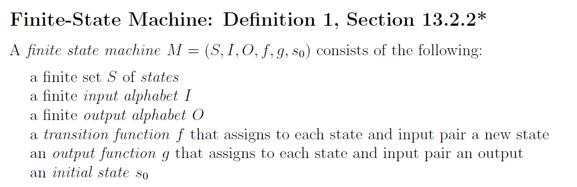
Definition

Slide 37
COVID Model
S
E
I
R
S = susceptible
E = exposed (but not infectious)
I = infectious
R = removed

Slide 38
COVID Model
I⁺
S
E
R
I⁻
S = susceptible
E = exposed (but not infectious)
I⁺ = infectious and symptomatic
I⁻ = infectious and asymptomatic
R = removed

Slide 39
Definition
S
E
I
R

Slide 40
Definition
S
E
I
R

Slide 41
Definition
S
E
I
R

Slide 42
Definition
S
E
I
R

Slide 43
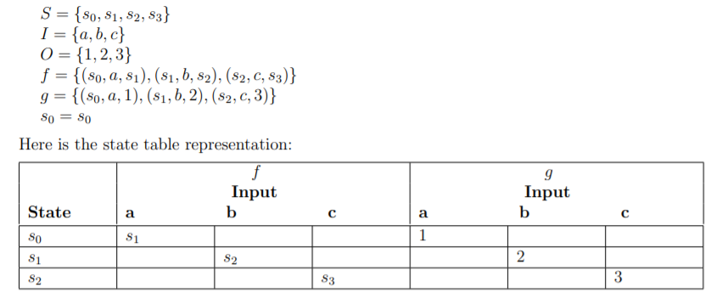
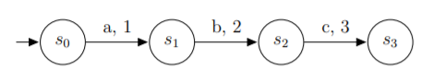
Finite-State Machines: Def 1 §13.2.2
Three FSM representations: sets, state diagram, or table

Slide 44
Finite-State Machines: Def 1 §13.2.2
Three FSM representations: sets, state diagram, or table
using the notation about functions
from last class period

Slide 45
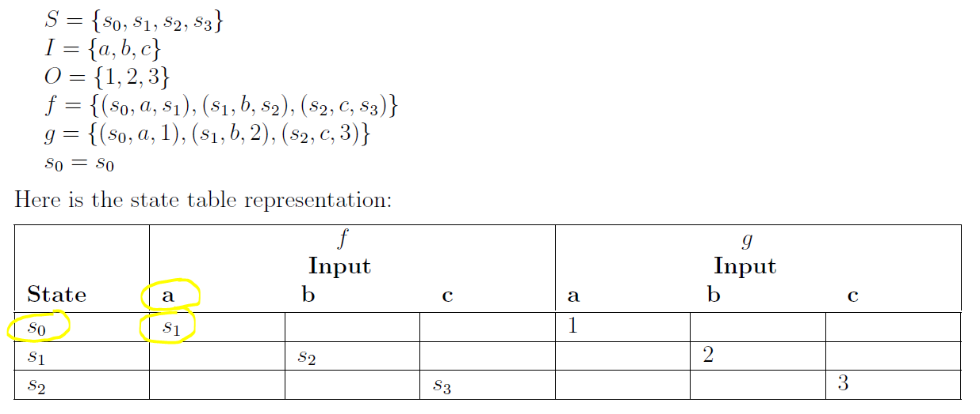
Finite-State Machines - Input
Three FSM representations: sets, state diagram, or table
Review Definition 1, Section 13.2.2
current state

Slide 46
Finite-State Machines - Input
Three FSM representations: sets, state diagram, or table
Review Definition 1, Section 13.2.2
input

Slide 47
Finite-State Machines - Input
Three FSM representations: sets, state diagram, or table
Review Definition 1, Section 13.2.2
next state

Slide 48
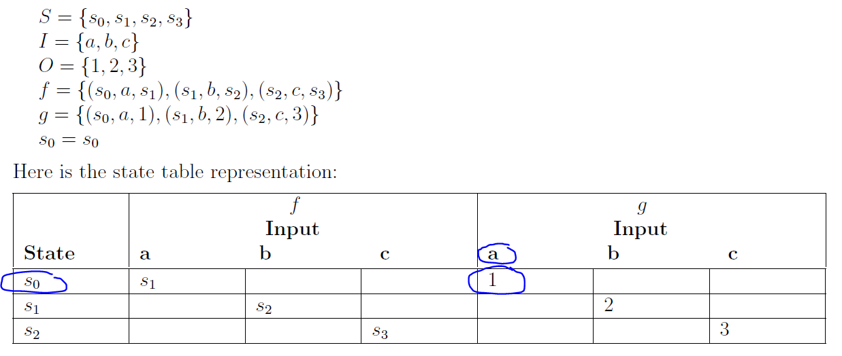
Finite-State Machines - Output
Three FSM representations: sets, state diagram, or table
Review Definition 1, Section 13.2.2
current state

Slide 49
Finite-State Machines - Output
Three FSM representations: sets, state diagram, or table
Review Definition 1, Section 13.2.2
current state

Slide 50
Finite-State Machines - Output
Three FSM representations: sets, state diagram, or table
Review Definition 1, Section 13.2.2
input

Slide 51
Finite-State Machines - Output
Three FSM representations: sets, state diagram, or table
Review Definition 1, Section 13.2.2
output

Slide 52
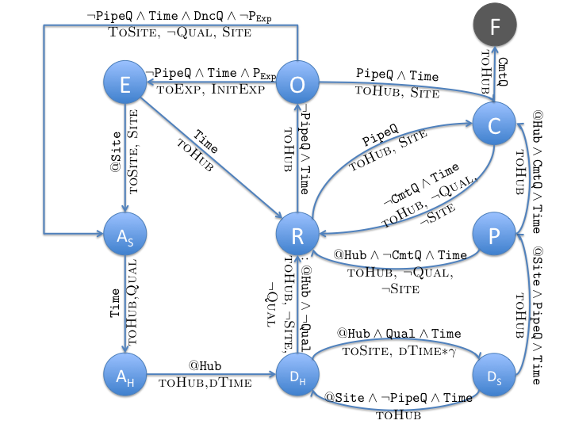
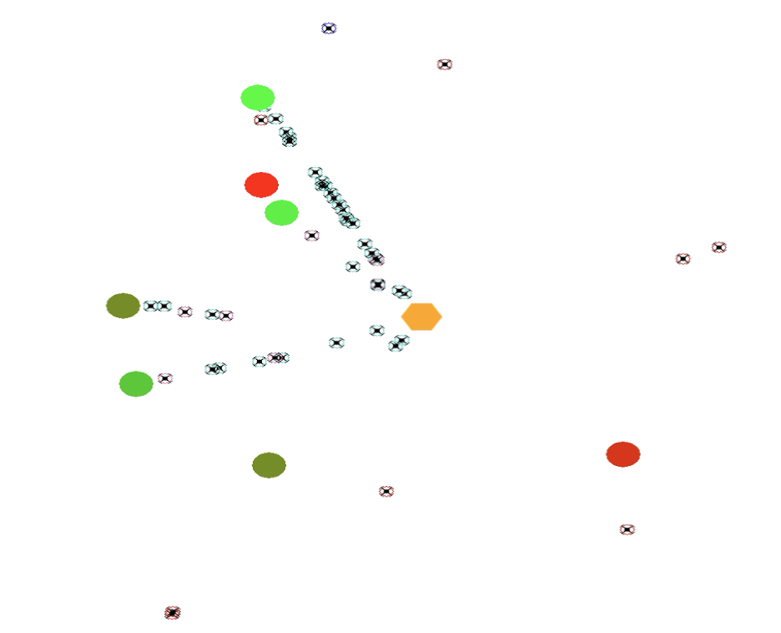
Example – Honeybees looking for a nest
Rest
Observe
Explore
Assess
Dance
Pipe
Commit
Notes:
Actual model used in the video.
The words above the transition is input that determines the transition, like timing out and resting after exploring for a long time
The small caps words under the transition describes what behaviors the honeybees will perform, like go to the hub and remember the site.

Slide 53


Example – Honeybees looking for a nest
Notes:
Gist of behavior

Slide 54
FSM Practice
I = {0, 1}
O = {Marco, Polo}
Create a finite-state machine that outputs “Marco” every time it reads a 1 and “Polo” every time it reads a 0
I = {0,1}
O = {Marco, Polo}

Slide 55
FSM Practice
I = {0, 1}
O = {Marco, Polo}
Create a finite-state machine that outputs “Marco” every time it reads a 1 and “Polo” every time it reads a 0
I = {0, 1}
0 , “Polo”
s₀
1 , “Marco”

Slide 56
FSM Exercise
I = {0, 1}
O = {Marco, Polo}
The two FSMs are equivalent because they give the exact same output for all inputs
0 , “Polo”
0 , “Polo”
0 , “Polo”
s₀
s₀
s₁
1 , “Marco”
1 , “Marco”
1 , “Marco”

Slide 57
Applying FSMs to Lexing

Slide 58
A Slight Twist on the Automata
Finite State Machine
Pattern
Finite State Machine
Specific
string
Output the
pattern name

Slide 59
What is a Lexer?
The lexer is a collection of state machines,
each tuned to look for a particular pattern.
When a machine finds the pattern, it outputs
the pattern name, which we call a token
Datalog program
Lexer
Parser
Execution
tokens
“meaning”
Stream from program one char at a time.
Output sequence (vector) of tokens.

Slide 60
What is a Lexer?
A lexer is a program that turns programmer-specific “items” into programmer-independent structures called “tokens”
Each token contains the information the computer needs:
a token name, which is selected from a set of predefined names, e.g. “STRING”
the specific “item” for that token, e.g. "Hello World“
a line number
A token encodes the text into the corresponding symbols of the programming language of the file
The output of the lexer is an ordered collection of tokens

Slide 61
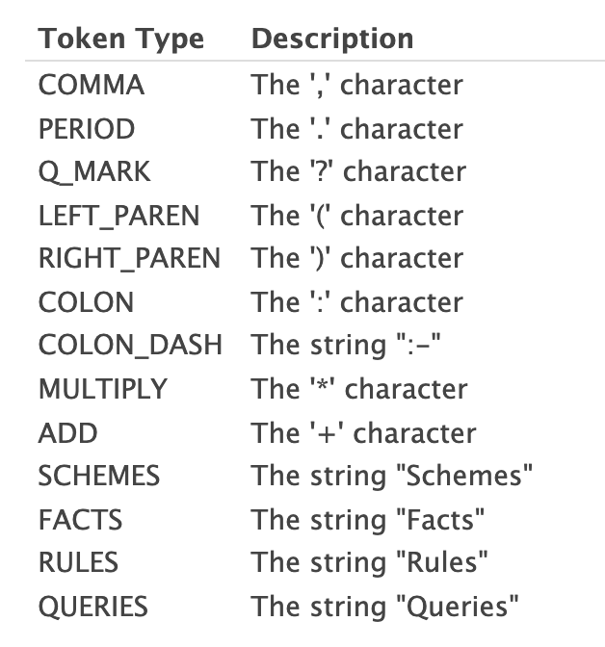
Using FSMs to lex Datalog
Datalog code
Rules:
marriedTo(X,Y) :- marriedTo(Y,X).
Create a state machine that outputs “RULES” if the
input sequence is “Rules” and otherwise outputs “fail”

Slide 62
Project 1: FSM for “Rules” Datalog keyword
s₀
R , λ
not R , fail
s₁
not u , fail
u , λ
s₂
not l , fail
s_{fail}
l , λ
not e , fail
anythihg , λ
s₃
not s , fail
e , λ
anything , oops
s₄
s , RULES
s₅

Slide 63
Project 1: FSM for “Rules” Datalog keyword
s₀
R , λ
not R , fail
s₁
not u , fail
u , λ
s₂
not l , fail
s_{fail}
l , λ
not e , fail
anythihg , λ
s₃
not s , fail
e , λ
anything , oops
s₄
Functions, not partial functions Use an error state
You have to specify a state transition for every input from every state
You have to specify an output for every input from every state
s , RULES
s₅

Slide 64
Running a Finite State Machine
Traces

Slide 65
Project 1: FSM for “Rules” Datalog keyword
s₀
Let’s do a trace on two different inputs
R , λ
not R , fail
s₁
not u , fail
u , λ
s₂
not l , fail
s_{fail}
l , λ
not e , fail
anythihg , λ
s₃
not s , fail
e , λ
anything , oops
s₄
s , RULES
s₅

Slide 66
Project 1: FSM for “Rules” Datalog keyword
s₀
Let’s do a trace on two different inputs
R , λ
not R , fail
Input string
Output
s₁
not u , fail
Rules
u , λ
s₂
not l , fail
s_{fail}
l , λ
not e , fail
anythihg , λ
s₃
not s , fail
e , λ
anything , oops
s₄
s , RULES
s₅

Slide 67
Project 1: FSM for “Rules” Datalog keyword
s₀
Let’s do a trace on two different inputs
R , λ
not R , fail
Input string
Output
s₁
not u , fail
Rules
u , λ
s₂
not l , fail
s_{fail}
l , λ
not e , fail
anythihg , λ
s₃
not s , fail
e , λ
anything , oops
s₄
s , RULES
s₅

Slide 68
Project 1: FSM for “Rules” Datalog keyword
s₀
Let’s do a trace on two different inputs
R , λ
not R , fail
Input string
Output
s₁
not u , fail
Rules
u , λ
s₂
not l , fail
s_{fail}
l , λ
not e , fail
anythihg , λ
s₃
not s , fail
e , λ
anything , oops
s₄
s , RULES
s₅

Slide 69
Project 1: FSM for “Rules” Datalog keyword
s₀
Let’s do a trace on two different inputs
R , λ
not R , fail
Input string
Output
s₁
not u , fail
Rules
u , λ
s₂
not l , fail
s_{fail}
l , λ
not e , fail
anythihg , λ
s₃
not s , fail
e , λ
anything , oops
s₄
s , RULES
s₅

Slide 70
Project 1: FSM for “Rules” Datalog keyword
s₀
Let’s do a trace on two different inputs
R , λ
not R , fail
Input string
Output
s₁
not u , fail
Rules
u , λ
s₂
not l , fail
s_{fail}
l , λ
not e , fail
anythihg , λ
s₃
not s , fail
e , λ
anything , oops
s₄
s , RULES
s₅

Slide 71
Project 1: FSM for “Rules” Datalog keyword
s₀
Let’s do a trace on two different inputs
R , λ
not R , fail
Input string
Output
s₁
not u , fail
Rules
λ
u , λ
s₂
not l , fail
s_{fail}
l , λ
not e , fail
anythihg , λ
s₃
not s , fail
e , λ
anything , oops
s₄
s , RULES
s₅

Slide 72
Project 1: FSM for “Rules” Datalog keyword
s₀
Let’s do a trace on two different inputs
R , λ
not R , fail
Input string
Output
s₁
not u , fail
Rules
λ
u , λ
s₂
not l , fail
s_{fail}
l , λ
not e , fail
anythihg , λ
s₃
not s , fail
e , λ
anything , oops
s₄
s , RULES
s₅

Slide 73
Project 1: FSM for “Rules” Datalog keyword
s₀
Let’s do a trace on two different inputs
R , λ
not R , fail
Input string
Output
s₁
not u , fail
Rules
λ
u , λ
s₂
not l , fail
s_{fail}
l , λ
not e , fail
anythihg , λ
s₃
not s , fail
e , λ
anything , oops
s₄
s , RULES
s₅

Slide 74
Project 1: FSM for “Rules” Datalog keyword
s₀
Let’s do a trace on two different inputs
R , λ
not R , fail
Input string
Output
s₁
not u , fail
Rules
λ
u , λ
s₂
not l , fail
s_{fail}
l , λ
not e , fail
anythihg , λ
s₃
not s , fail
e , λ
anything , oops
s₄
s , RULES
s₅

Slide 75
Project 1: FSM for “Rules” Datalog keyword
s₀
Let’s do a trace on two different inputs
R , λ
not R , fail
Input string
Output
s₁
not u , fail
Rules
λ
u , λ
s₂
not l , fail
s_{fail}
l , λ
not e , fail
anythihg , λ
s₃
not s , fail
e , λ
anything , oops
s₄
s , RULES
s₅

Slide 76
Project 1: FSM for “Rules” Datalog keyword
s₀
Let’s do a trace on two different inputs
R , λ
not R , fail
Input string
Output
s₁
not u , fail
Rules
RULES
u , λ
s₂
not l , fail
s_{fail}
l , λ
not e , fail
anythihg , λ
s₃
not s , fail
e , λ
anything , oops
s₄
s , RULES
s₅

Slide 77
Another input

Slide 78
Project 1: FSM for “Rules” Datalog keyword
s₀
Let’s do a trace on two different inputs
R , λ
not R , fail
Input string
Output
s₁
not u , fail
Rust
λ
u , λ
s₂
not l , fail
s_{fail}
l , λ
not e , fail
anythihg , λ
s₃
not s , fail
e , λ
anything , oops
s₄
s , RULES
s₅

Slide 79
Project 1: FSM for “Rules” Datalog keyword
s₀
Let’s do a trace on two different inputs
R , λ
not R , fail
Input string
Output
s₁
not u , fail
Rust
λ
u , λ
s₂
not l , fail
s_{fail}
l , λ
not e , fail
anythihg , λ
s₃
not s , fail
e , λ
anything , oops
s₄
s , RULES
s₅

Slide 80
Project 1: FSM for “Rules” Datalog keyword
s₀
Let’s do a trace on two different inputs
R , λ
not R , fail
Input string
Output
s₁
not u , fail
Rust
fail
u , λ
s₂
not l , fail
s_{fail}
l , λ
not e , fail
anythihg , λ
s₃
not s , fail
e , λ
anything , oops
s₄
s , RULES
s₅

Slide 81
Finite State Automaton
A cousin of a finite state machine

Slide 82
Formal definition (def 3 in §13.3.3)
A finite state automaton (FSA) is a tuple (S, I, s_{o}, F, f)
Finite set of states: S
Set of input characters: I
Start state: s_{o}
Set of final or accept states: F
Transition function: f: S ⨉ I ⟶ S

Slide 83
Formal definition (def 3 in §13.3.3)
A finite state automaton (FSA) is a tuple (S, I, s_{o}, F, f)
Finite set of states: S
Set of input characters: I
Start state: s_{o}
Set of final or accept states: F
Transition function: f: S ⨉ I ⟶ S

Slide 84
Formal definition (def 3 in §13.3.3)
A finite state automaton (FSA) is a tuple (S, I, s_{o}, F, f)
Finite set of states: S
Set of input characters: I
Start state: s_{o}
Set of final or accept states: F
Transition function: f: S ⨉ I ⟶ S
What’s the same?

Slide 85
Formal definition (def 3 in §13.3.3)
A finite state automaton (FSA) is a tuple (S, I, s_{o}, F, f)
Finite set of states: S
Set of input characters: I
Start state: s_{o}
Set of final or accept states: F
Transition function: f: S ⨉ I ⟶ S
What’s different?

Slide 86
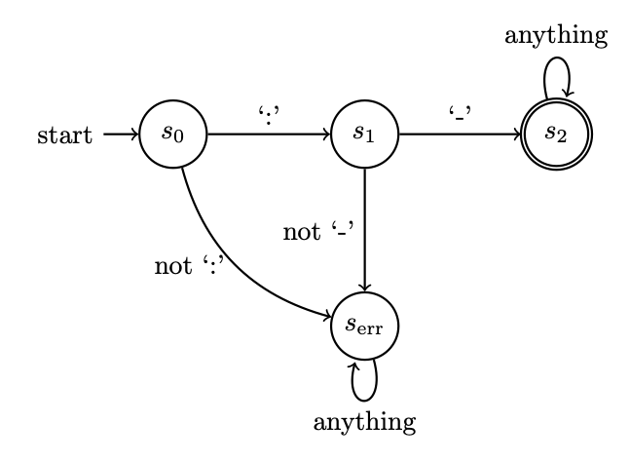
Example FSA
Tuple (S, I, s_{o}, F, f)
Finite set of states: S
Set of input characters: I
Start state: s_{o}
Set of final or accept states: F
Transition function: f: S ⨉ I ⟶ S

Slide 87
Practice

Slide 88
Design a finite state machine that outputs “COLON-DASH” only if the input string is “:-”
Design a finite state automaton that succeeds only if the input string is “:-”
Pattern
Pattern
Finite State Machine
Finite State Automaton
Specific
string
Specific
string
Output the
pattern name
Does that specific
string match that pattern

Slide 89
Design a finite state machine that outputs “COLON-DASH” only if the input string is “:-”
Design a finite state automaton that succeeds only if the input string is “:-”

Slide 90
Design a finite state machine that outputs “COLON-DASH” only if the input string is “:-”
Design a finite state automaton that succeeds only if the input string is “:-”
-, COLON-DASH
s₀
: , λ
s₂
s₁
not : , fail
not - , fail
s_{fail}

Slide 91
Design a finite state machine that outputs “COLON-DASH” only if the input string is “:-”
Design a finite state automaton that succeeds only if the input string is “:-”
-, COLON-DASH
s₀
: , λ
s₂
s₁
not : , fail
not - , fail
s_{fail}

Slide 92
Design a finite state machine that outputs “COLON-DASH” only if the input string is “:-”
Design a finite state automaton that succeeds only if the input string is “:-”
-, COLON-DASH
s₀
: , λ
s₂
s₁
not : , fail
not - , fail
s_{fail}

Slide 93
Example FSA
Tuple (S, I, s_{o}, F, f)
Finite set of states: S
Set of input characters: I
Start state: s_{o}
Set of final or accept states: F
Transition function: f: S ⨉ I ⟶ S
A double circle represents an accept state

Slide 94
FSA Trace
Input string
Output
Rules

